Slide 1
“TO CRASH OR NOT TO CRASH?”
by Martin Zanaj

Slide 2
Purpose
This project is on airplane crashes and fatalities since 1908. The user of this dataset could be anyone that is planning a trip and wants to make informed decisions about their safety, with one potential question following being
What are the most common causes of accidents?

Slide 3
Data
The dataset was sourced from Kaggle, and it contained information regarding airplane crashes from 1908 up to 2019. The data covered crashes all around the world from both private and public domains.
Observations | 4967
Features | 13 date, time, location, operator, route, flight #, type, reg #, serial #, passengers, fatalities, ground, summary
 | date: years (1908-2019) operator: (military, commercial, civilian) summary: (description about incident)

Slide 4
Preprocessing
Through the aid of some NLP programs and techniques, each different accident summary was parsed in order to extract the most useful information in terms of possible crash causes.
Drop bad data (e.g. empty values)
Text Cleaning
Remove stop words, punctuation, digits, and duplicates from each observation
“Uniformize” words (e.g. stemming)
Focus on the most frequent causes (i.e. > 20+ occurrences)

Slide 5
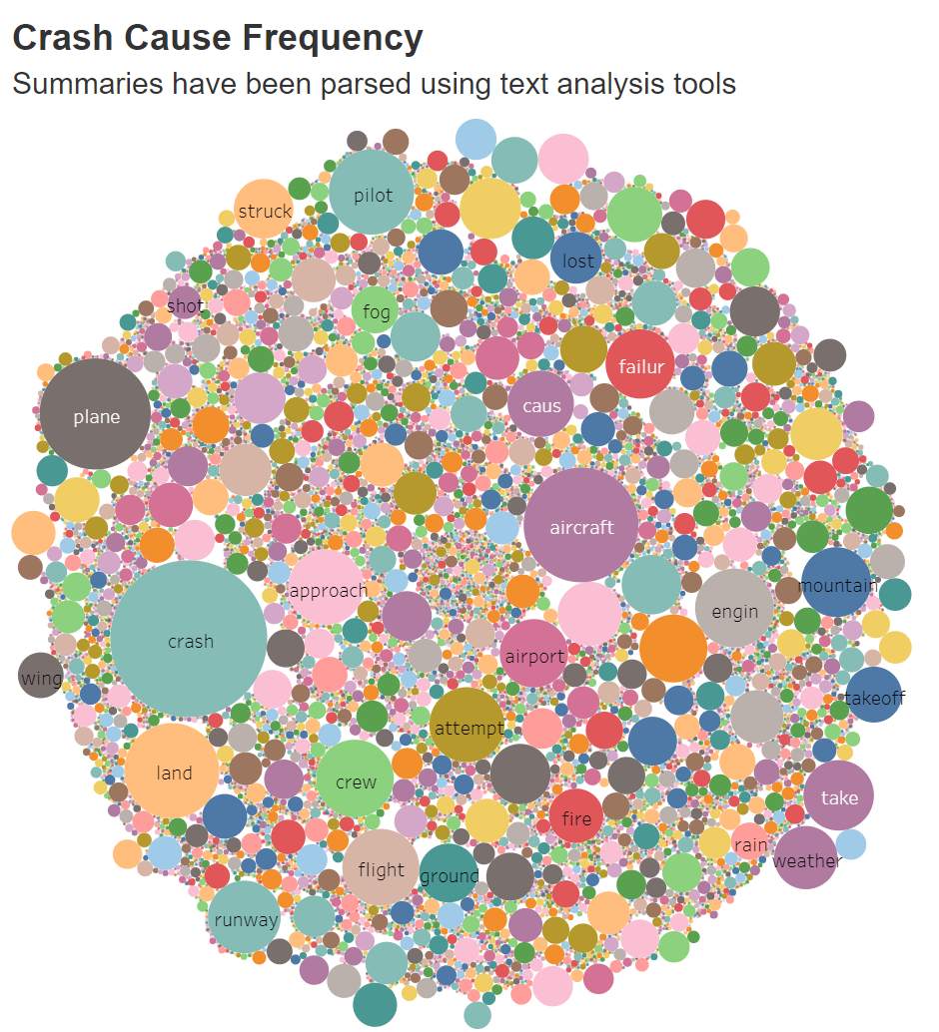
Analysis

Slide 6
Challenges
Picking the most frequent causes
Creating broad enough categories, yet specific
Reconciliation of similar crashes into one category
Choosing a scale to showcase the differences from each operator (military, commercial, civilian)

Slide 7
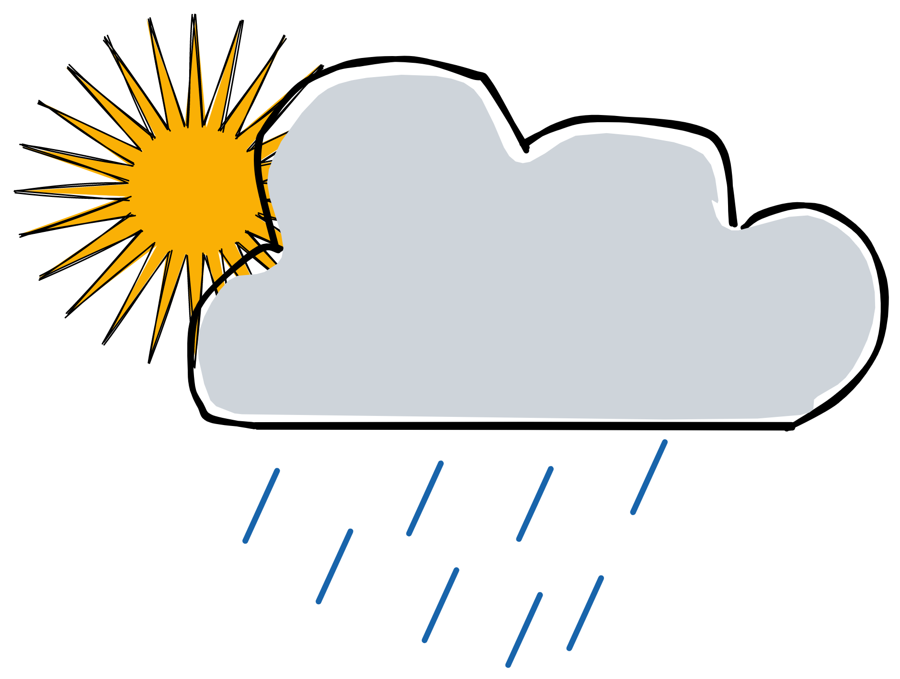

To the traveler,
“You shouldn’t worry too much about a possible crash, but if you really must, then you better check that there are no clouds in the sky upon your departure.”

Slide 8
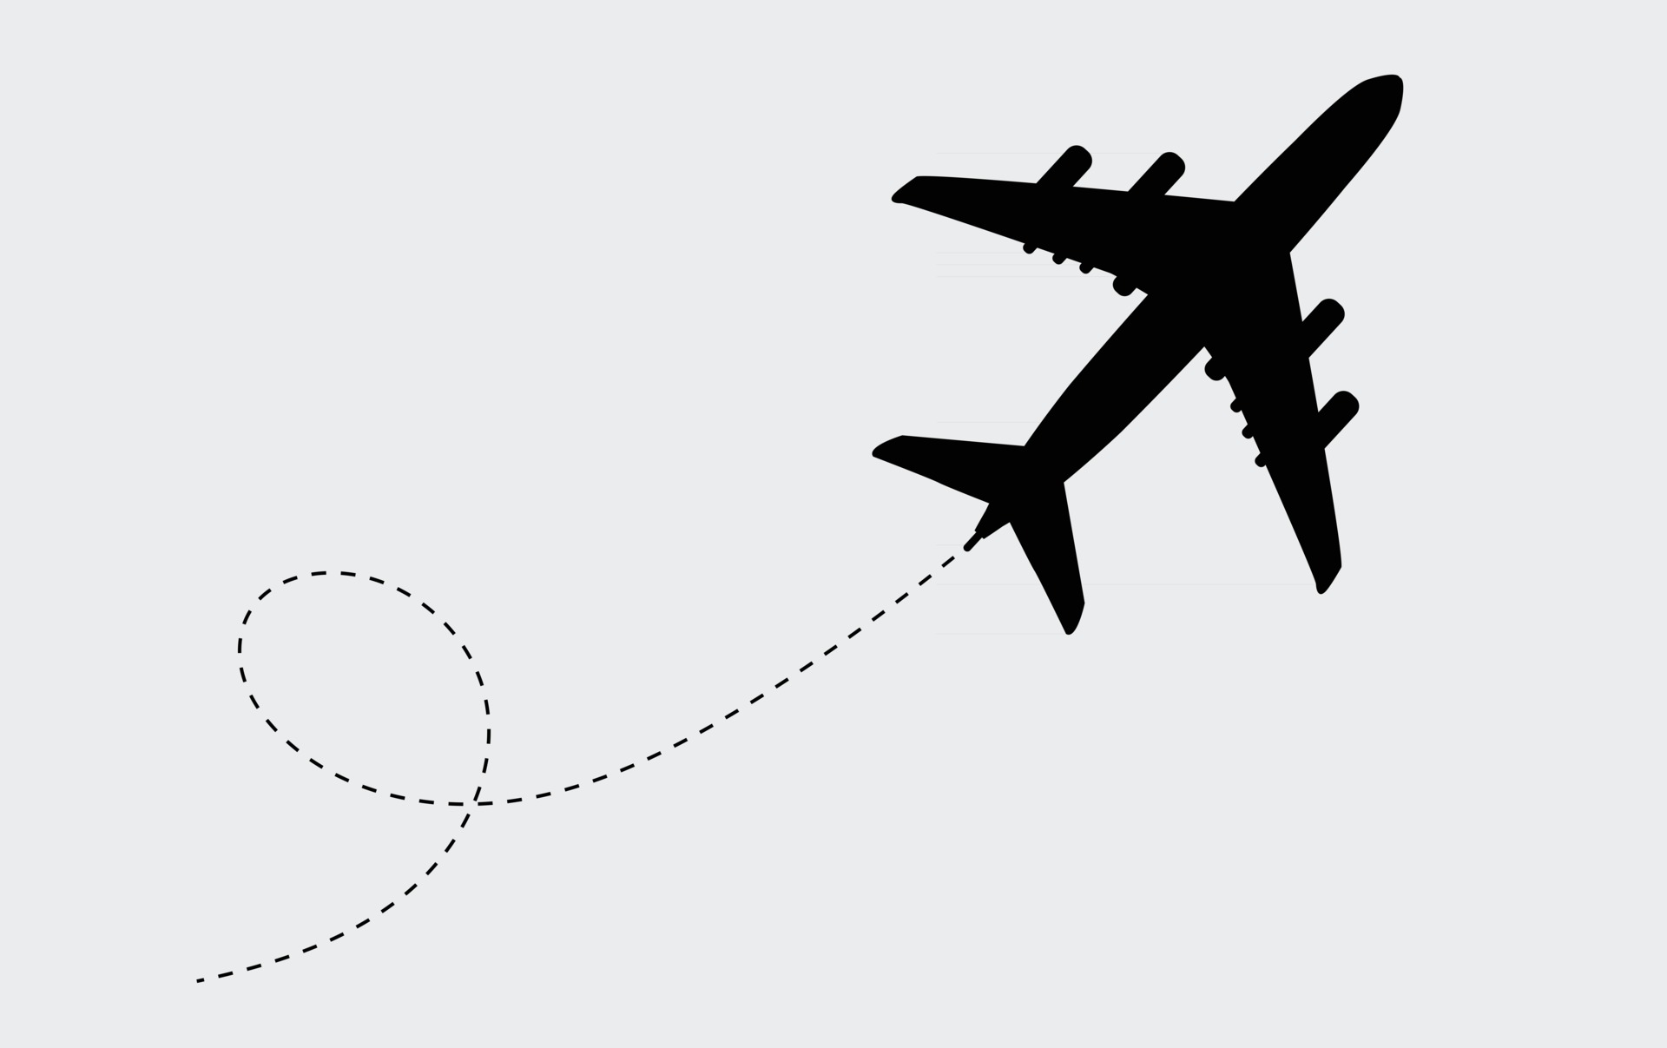
Thanks!
Any questions?

Slide 9
References
Dataset,
https://www.kaggle.com/datasets/cgurkan/airplane-crash-data-since-1908
Visualization,
https://public.tableau.com/app/profile/martin6851/viz/AirplaneFrequentCrashCauses/Dashboard1
Entire Analysis,
https://elaineye117.github.io/flight_crash_analysis/
Airplane Image,
https://www.vecteezy.com/free-vector/airplane

